Slide 1
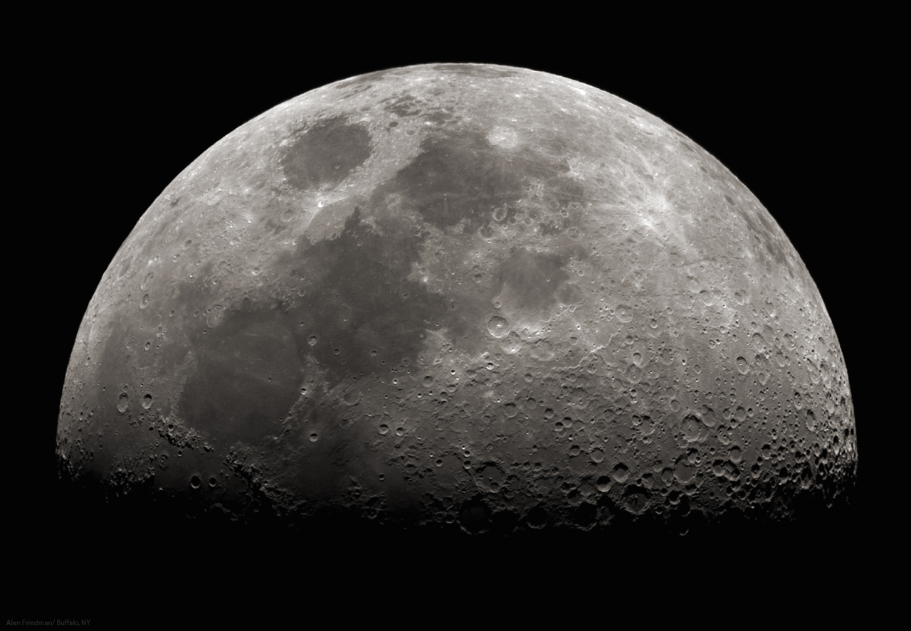
LUNAR SURVIVAL SKILLS

Slide 2
The Situation
You’re astronauts on your way to a lunar base.
Your spacecraft crashes onto the moon’s surface.
Everyone survives, but you’re a three day walk away from the base.
You’ll sort through 15 items and decide which are essential, helpful, and useless.
Be creative! You’re astronauts!

Slide 3
We’ll make three groups:
ESSENTIAL
HELPFUL
USELESS

Slide 4
Box of matches
Map of the stars
Food concentrate
Self-inflating life raft
18 m of nylon rope
Magnetic compass
Parachute silk
15 L of water
Solar-powered heater
Signal flares
Two pistols
First aid kit
One case powdered milk
Walkie Talkies
Two tanks of oxygen

